Slide 1
Introduction To Information Technology
Hardware And Software

Slide 2
Introduction to computer
Computer is an electronic semi-automatic device that takes input from the users process it and give output.

Slide 3
Input Devices
Input is all information put into a computer. Input can be supplied from a variety of sources:
Keyboard
Mouse
Scanner
Light pen
mic

Slide 4
Storage Technology
Magnetic storage devices store data by magnetizing particles on a disk or tape. They have a limited life-span of 1 to 5 years, depending on the device.
Optical storage devices store data as light and dark spots on the disk surface. They have an unlimited life-span

Slide 5
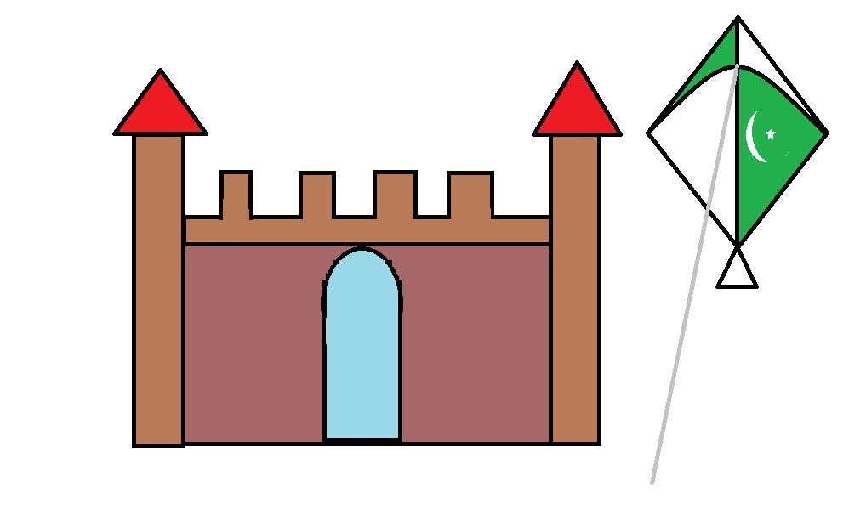
Hard disk
Hard Disk Drives
Capacity is measured in gigabytes (GB or billions of bytes).
Typically permanently installed.
Used to store operating system, application software, utilities and data.
Magnetic storage device

Slide 6
Hard disk
Hard Disk Drives
Capacity is measured in gigabytes (GB or billions of bytes).
Typically permanently installed.
Used to store operating system, application software, utilities and data.
Magnetic storage device

Slide 7
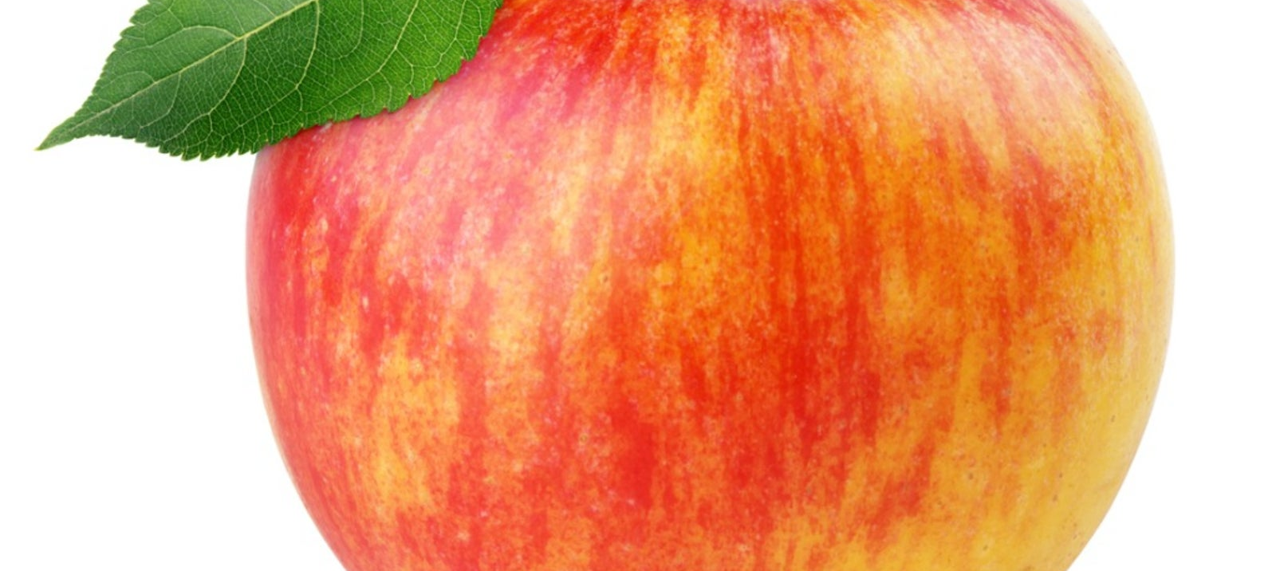
Apple
Hard Disk Drives
Capacity is measured in gigabytes (GB or billions of bytes).
Typically permanently installed.
Used to store operating system, application software, utilities and data.
Magnetic storage device

Slide 8
What is the internet
Internet is a global system of interconnected computer networks that use the standard Internet protocol (often called TCP/IP) to serve billions of users worldwide. It is a network of networks that consists of millions of private, public, academic, business, and government networks, of local to global scope, that are linked by networking technologies.

Slide 9
Who Owns the Internet?
There are many organizations, corporations, governments, schools, private citizens and service providers that all own pieces of the infrastructure, but there is no one body that owns it all. There are, however, organizations that oversee and standardize what happens on the Internet and assign IP addresses and domain names, such as the National Science Foundation, the Internet Engineering Task Force, ICANN , InterNICand the Internet Architecture Board.

Slide 10
Disadvantages of the Internet
Although the Internet is one of the greatest creations, it also has many disadvantages. Because the internet is easily accessible to anyone, it can be a dangerous place. You have to know who you're dealing with or what you're getting into. Predators, cyber criminals, bullies, and corrupt businesses will try to take advantage of the unwary visitor.

